Slide 1
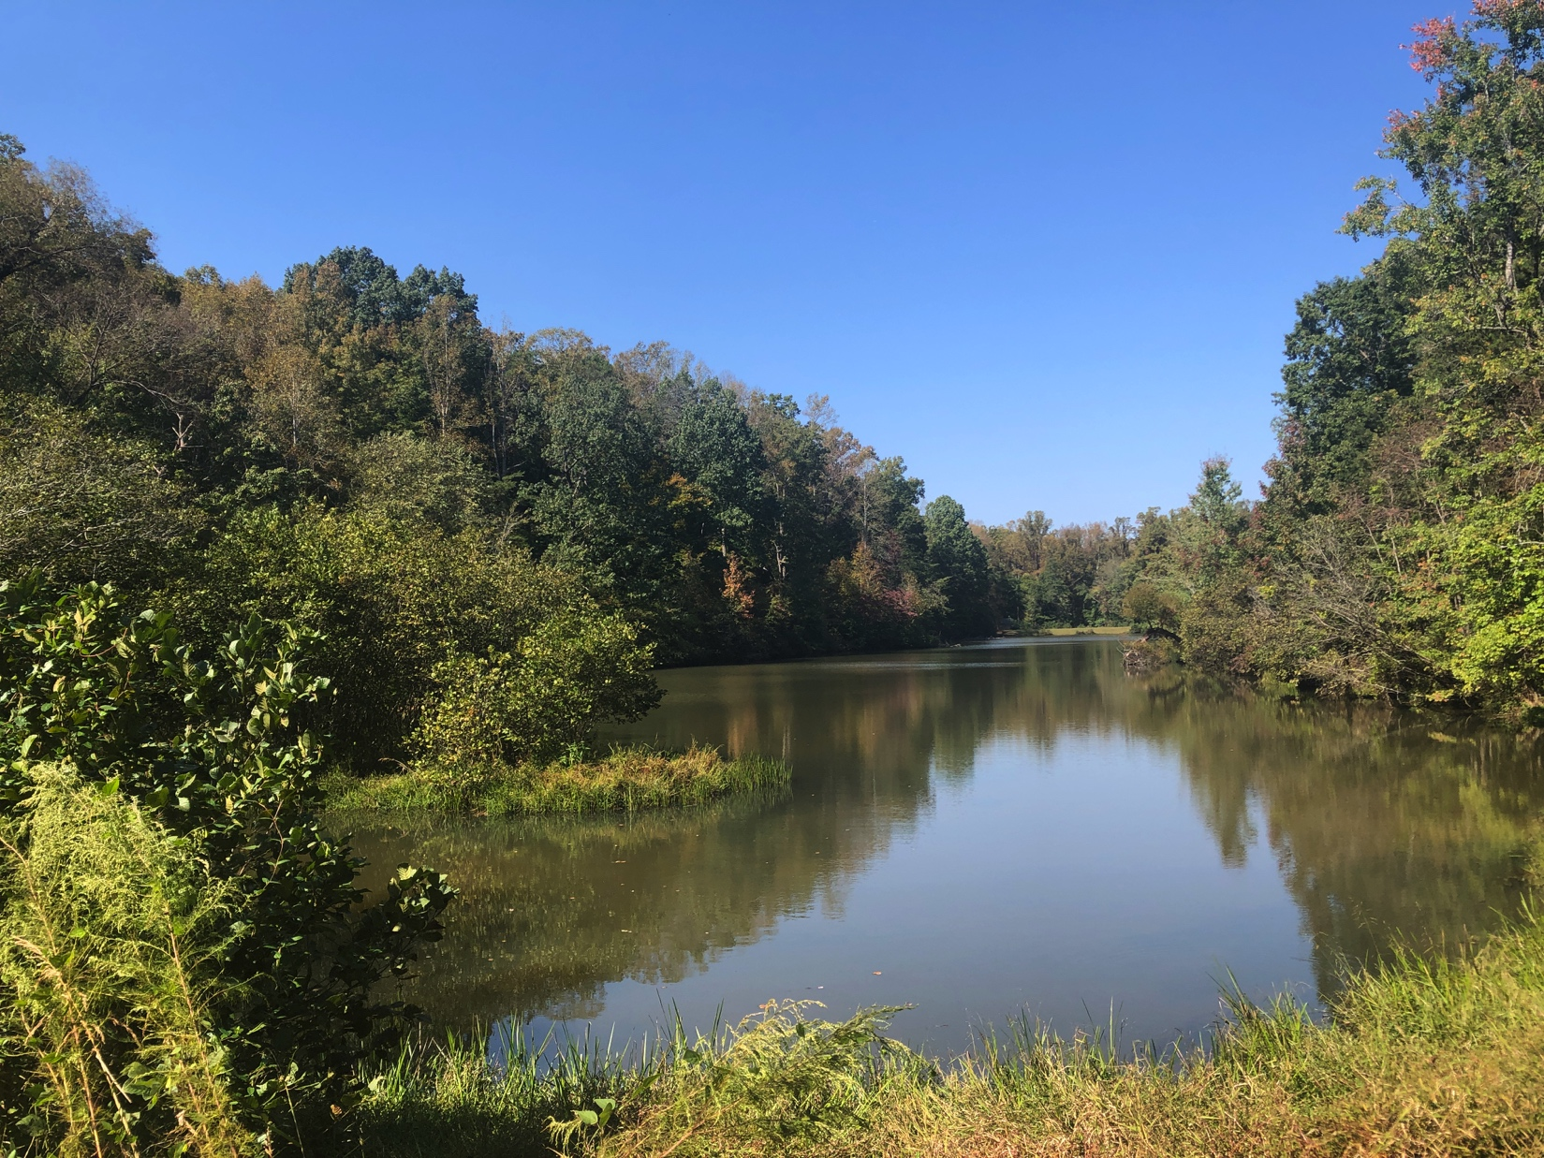

Parks On The Air
www.parksontheair.com

Slide 2
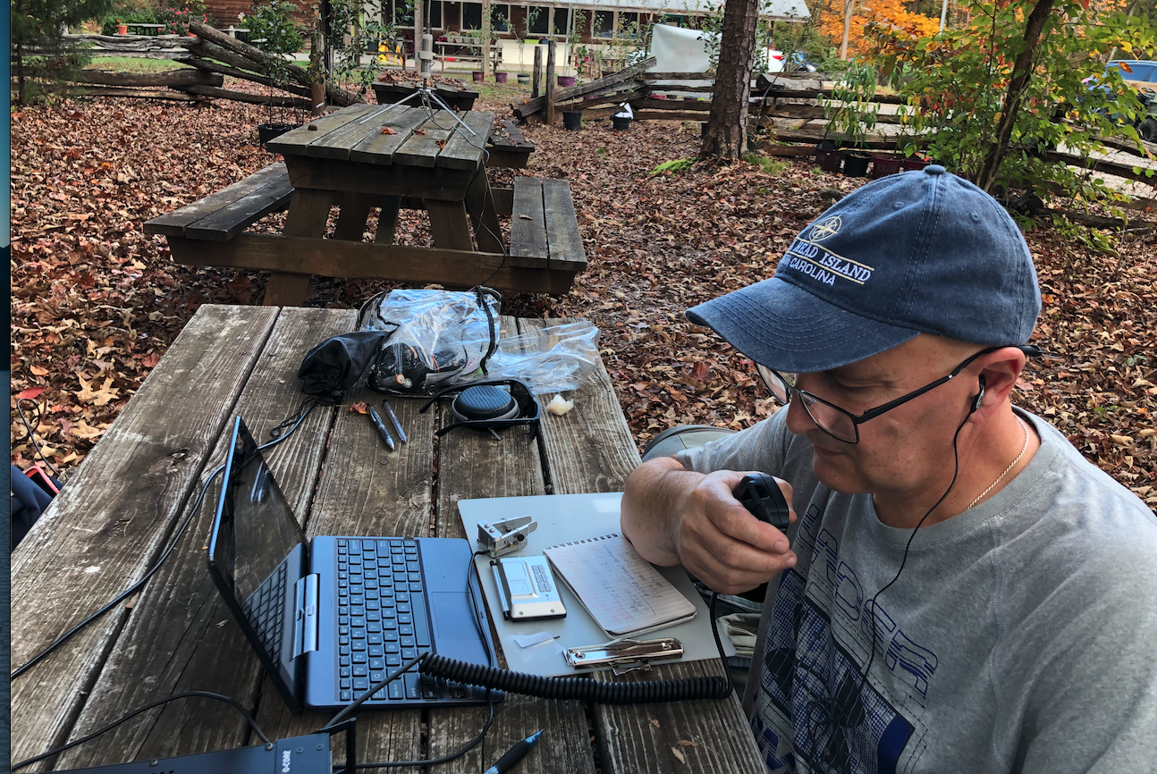

Parks On The Air - POTA
How to get started in POTA
What are common radios?
What types of antennas?
Different kind of batteries.
Logging and submitting logs.
Why POTA?
Get Outdoors
Enjoy our State & National Parks.
Be the station everyone wants to work.
Practice our Emergency Comms.
Have Fun.

Slide 3
Two Different Ways to Participate:
Activators:
Those operating from the
parks
Hunters:
Those contacting people
at the parks.

Slide 4

How to join the POTA fun
Creating an account is fast and easy.
POTA stores no passwords, we authenticate against accounts you already have.
Select the Dashboard/Login link at
parksontheair.com
info@parksontheair.com if you need assistance

Slide 5

How does it work for Activators?
Choose a reference to put on the air. POTA has over 10,000 locations in USA and Canada.
Find a list by state/province and maps at parksontheair.com

Slide 6
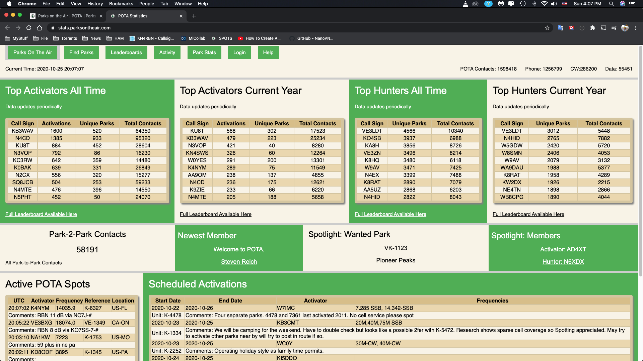

Slide 7
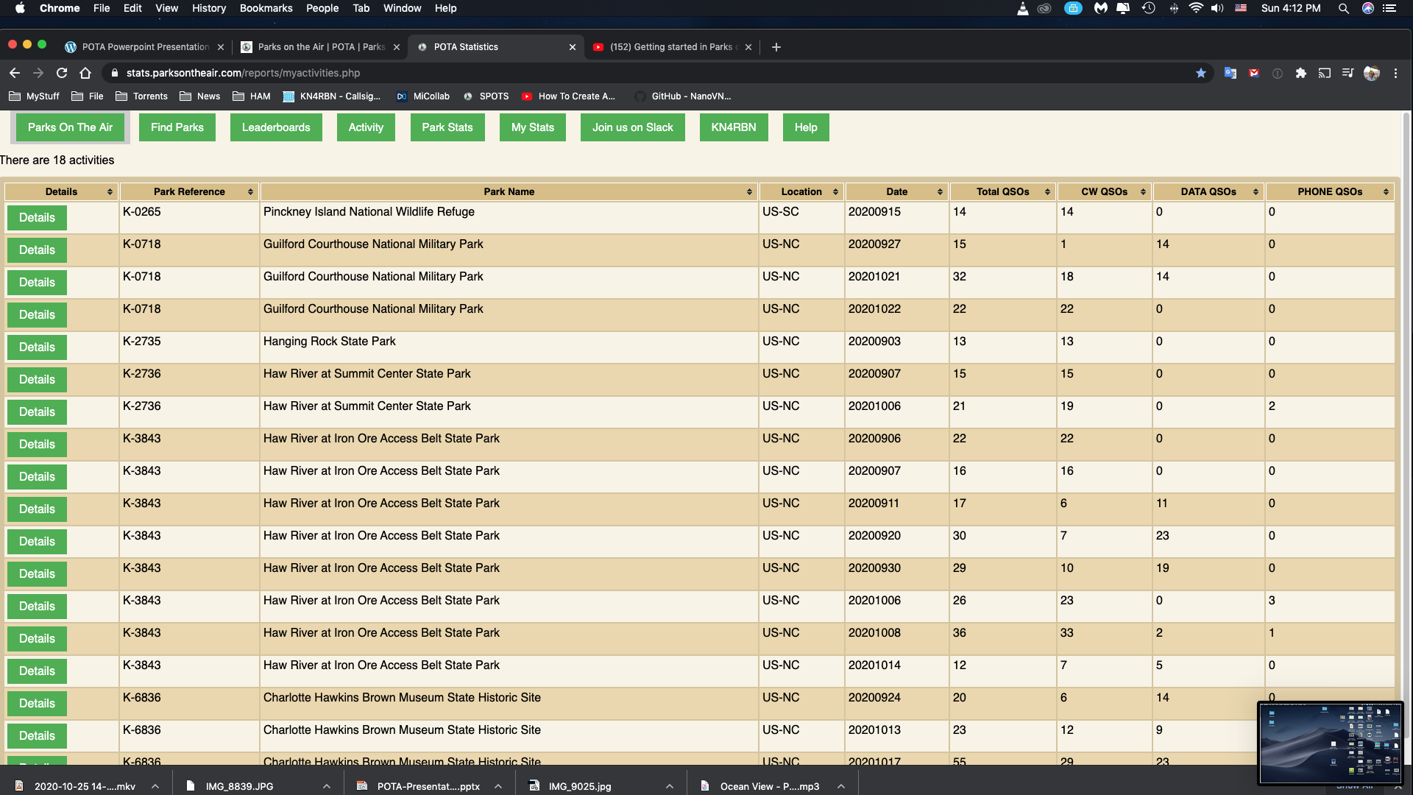

Slide 8
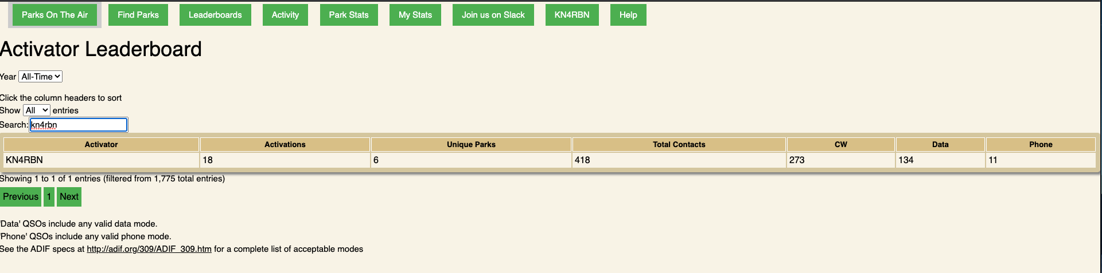
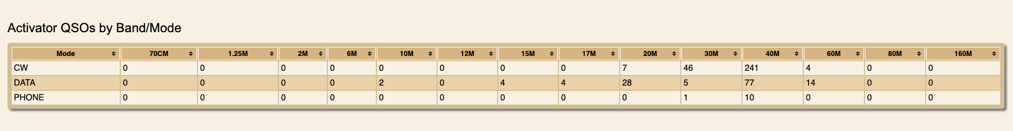
My total QSOs

Slide 9
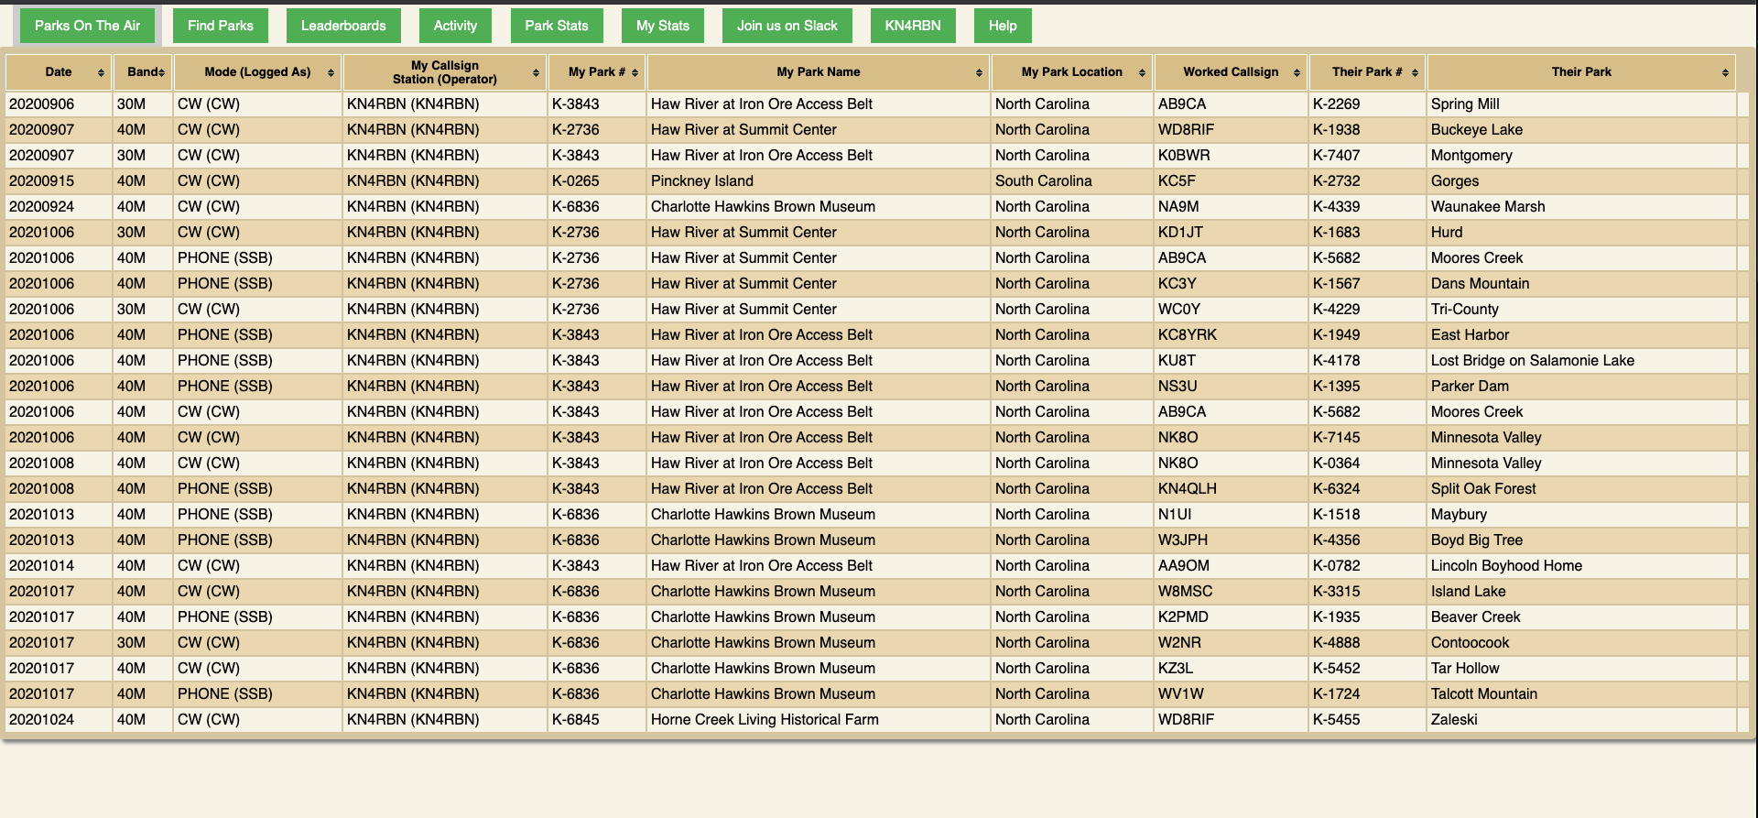
Park to Park QSOs

Slide 10
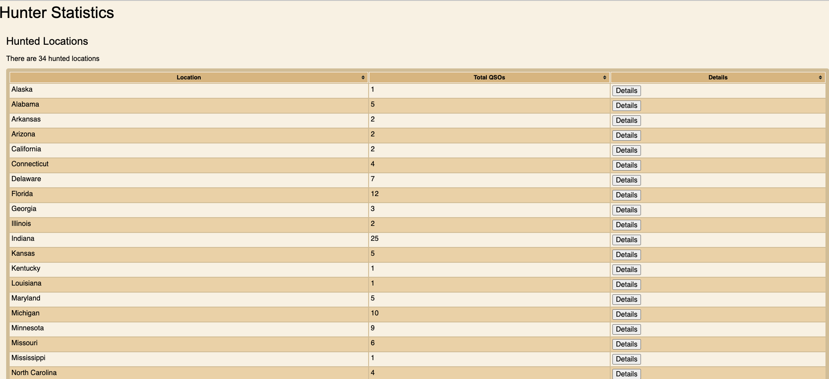

Slide 11
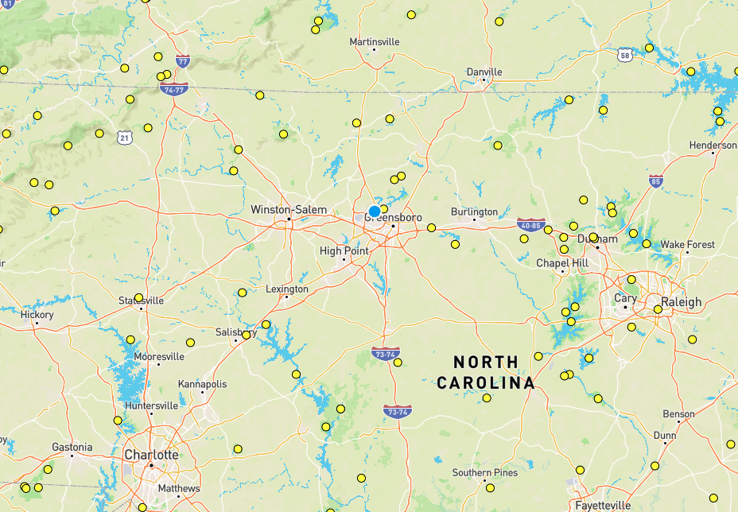
LOCAL GREENSBORO REFERENCES
Easy to drive to:
K-0718 Guilford Courthouse Park
K-6836 Charlotte Hawkins Brown Park
K-3843 Haw River at Iron Ore
K-2736 Haw River Summit Center
Short drive (~1 hr):
K-2750 Pilot Mountain State Park
K-6845 Horne Creek Living Historical K-2735 Hanging Rock State Park

Slide 12
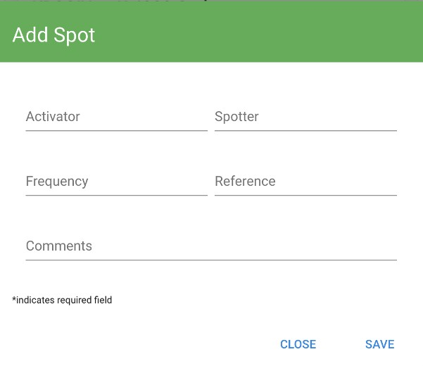

SSB any variation of the following:
HOW DO I CALL CQ
“CQ Parks on the Air CQ POTA
This is KN4RBN activating Park K-1880”
On CW we often hear:
“CQ POTA de KN4RBN KN4RBN K”
Then put yourself on the POTA Spotter and you will
be hunted!
Schedule an activation and the CW Reverse Beacon Network (RBN) can pick up your signal and you’ll be automatically spotted!
To get spotted by the RBN, repeat your callsign twice
like “CQ POTA W3AAX W3AAX K”

Slide 13

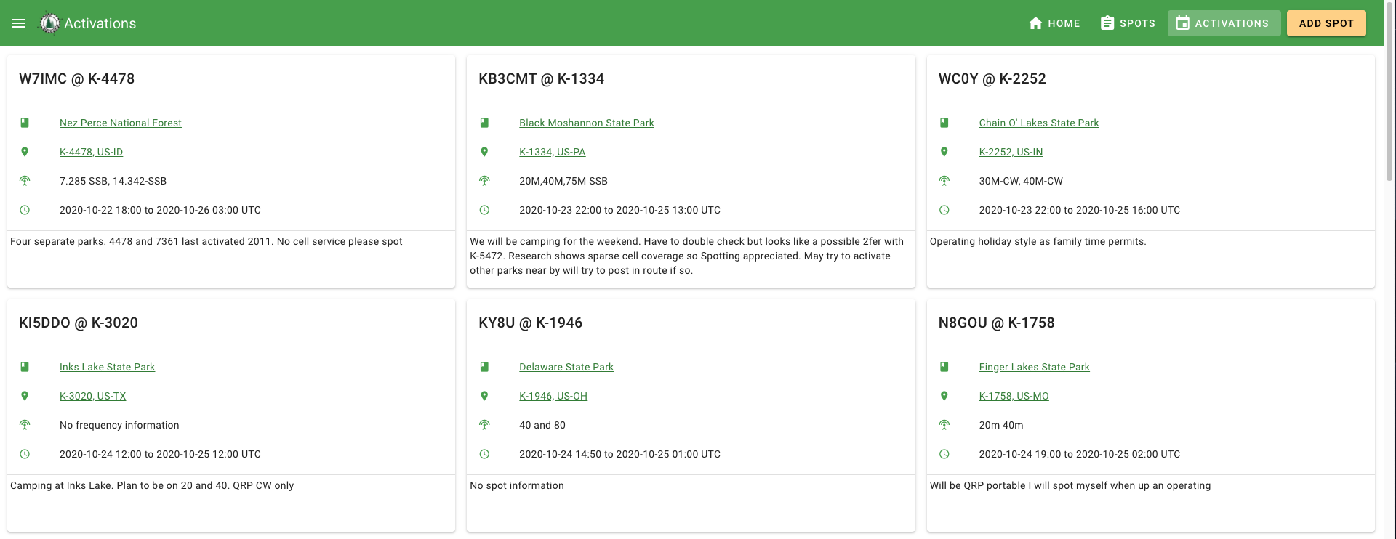
Advertise your activation!!!!
Post your activation on the spotting page ahead of time.
Self spotting is allowed. Others can spot and re-spot you too.
Be prepared for a pileup!

Slide 14
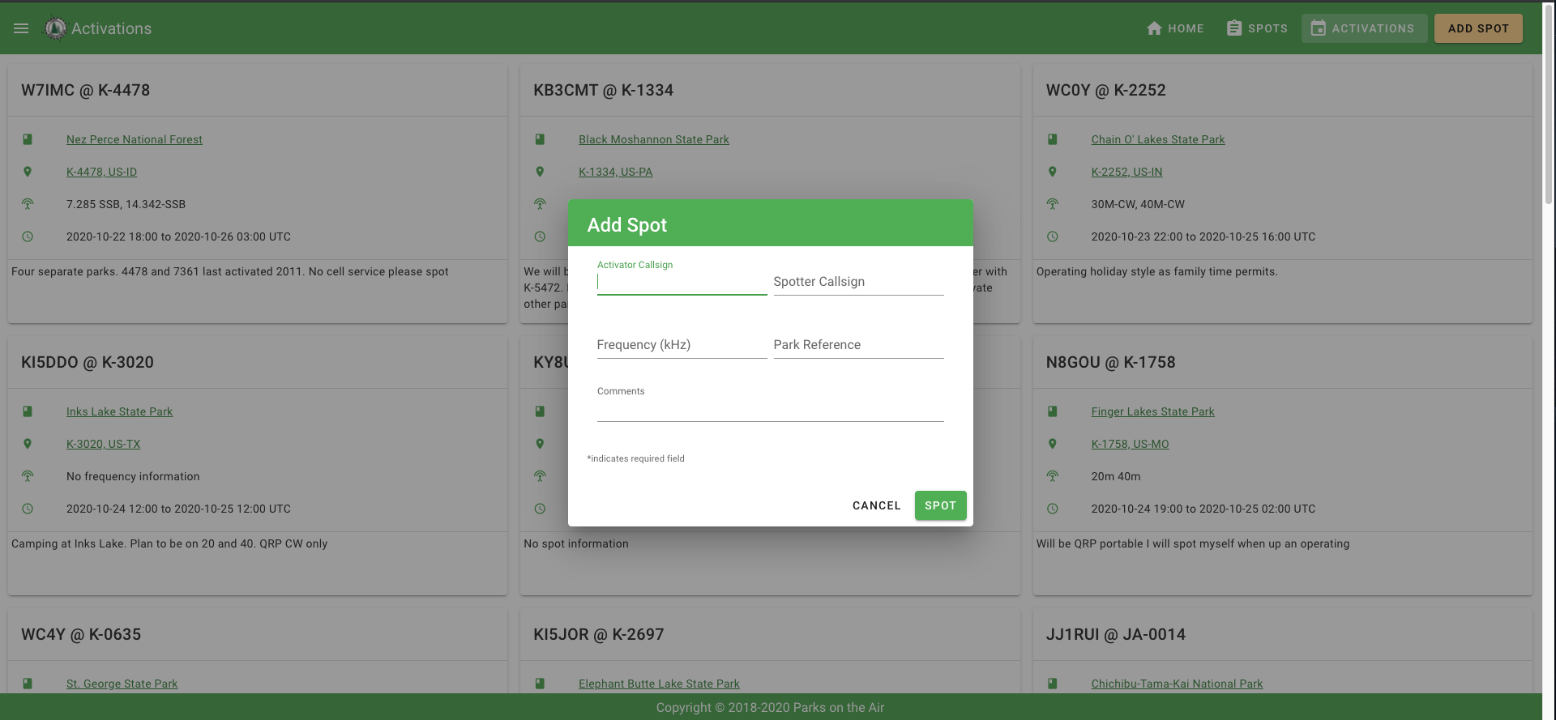
Spotting is easy

Slide 15

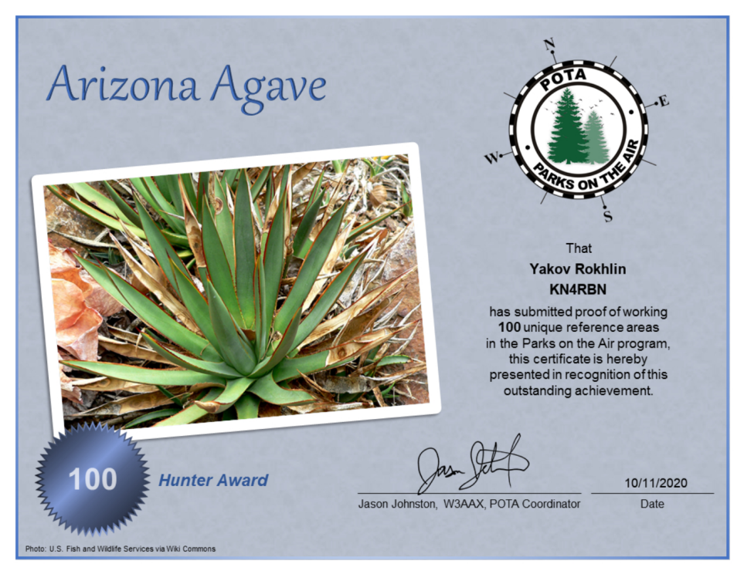
Activator Awards
Incremental awards, for each level of unique parks
activated.
Both Activators and Hunters get awards.
Hunters do not submit any logs.
You will be added when Activator submits their logs.

Slide 16
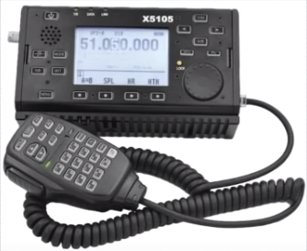
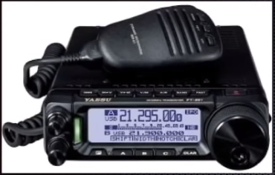
QRP Radios:
QRO Radios:
Yaesu FT-817/818
Xiegu G90
Xiegu X5105
Icom ic-703/705
Elecraft kx2/kx3
Yaesu FT 891/991
Icom IC-7300
Yaesu FT-857
Icom IC 706MKIIG

Slide 17
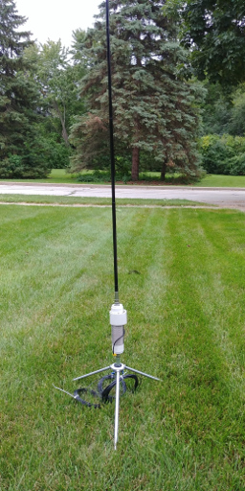
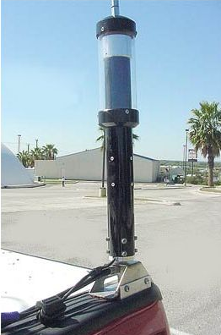
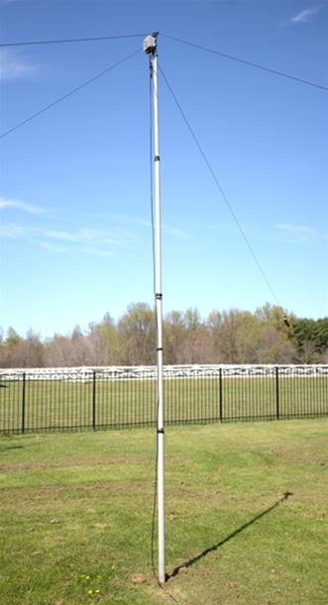
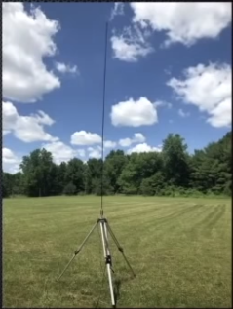
Type of antennas:
Wolf River Coils Little TarHeel II DX Commander Alpha Antennas

Slide 18
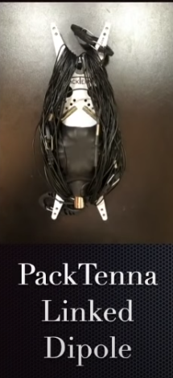
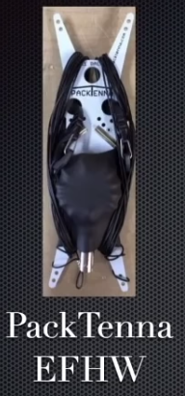
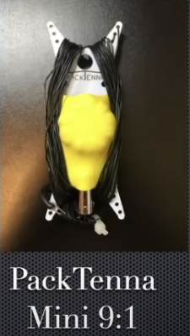
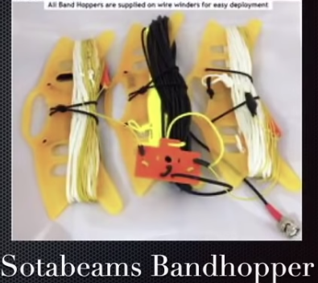
Wire Antennas:

Slide 19
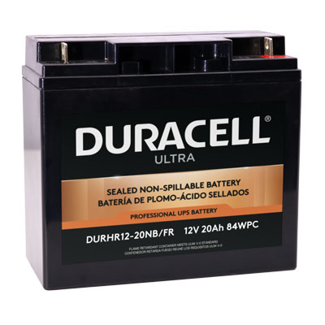
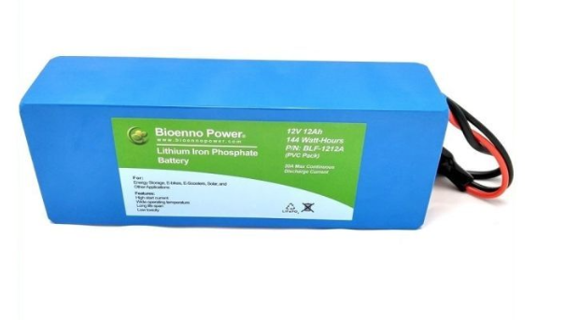
Batteries:
Sealed Lead Acid:
Good for QRP
500 Charge Cycle
Heavy
Lithium Iron Phosphate (LiFePO4):
Light Weight
90-100% Capacity
QRP or QRO
Extremely Safe
More Expensive

Slide 20
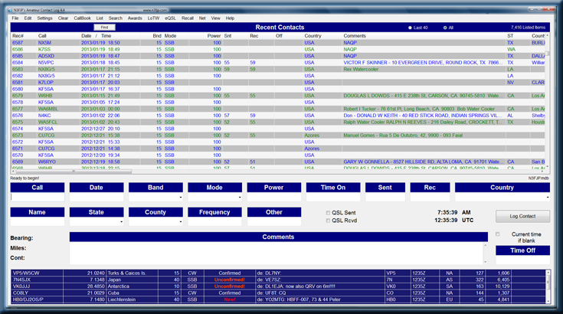
Computer Logging

Slide 21

Why would you enjoy hunting POTA activators?
You are helping another amateur to reach their goals
It’s an easy, short contact - great for new HF operators.
Enjoy the comprehensive stats and awards POTA provides.
It requires no log submissions
It makes you a better operator and keeps your skills sharp.
You will make friends from all over world
You can hunt as much or as little as you want, you do not even have to register to play.
You can help the activators by relaying things like “you
have a Park to Park calling” or by spotting when they QSY

Slide 22
My equipment
Xiegu G90 (20W,w/tuner)
12Ah Bioenno LiFePo4 battery (also have 12Ah and 6Ah LiFePo4)
Wolf River Coils Vertical Antenna
End Fed with (9:1 UNUN):
50ft RG-8X coax
N3FJP logging software
Depending on location:
Solar generator, laptop, folding table and chairs.

Slide 23

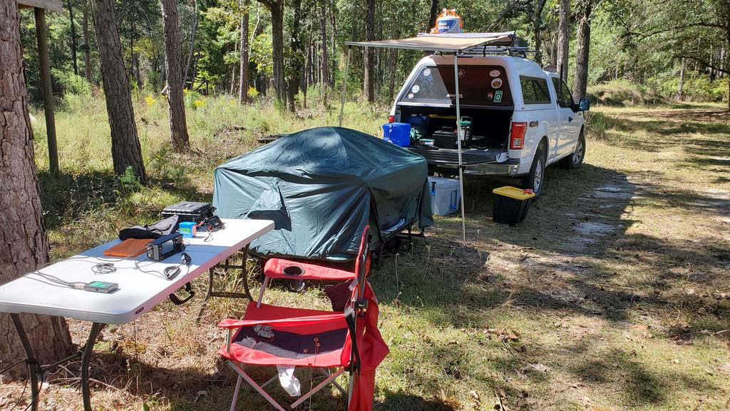
Activate while camping!

Slide 24
Questions?
Feel free to email me at: rokhlin@gmail.com

