Slide 1
Building a Solar Generator
KC4WGA – Carl Fenske
KC4WGA@gmail.com

Slide 2
Why Build a Solar Generator?
Portable Operation
Emergency Power
Field Day – ARRL
Winter Field Day
Jamboree-on-the-Air (BSA)

Slide 3
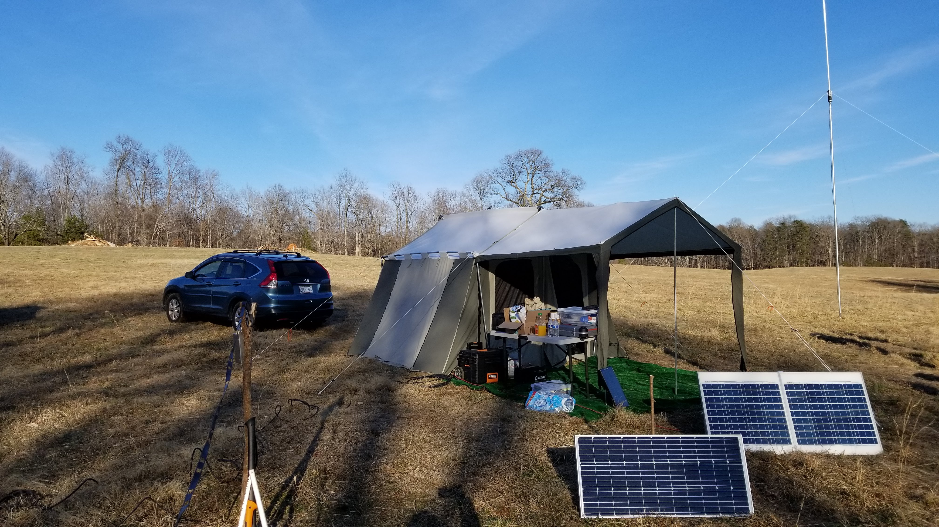
Why Build a Solar Generator?
Notes:
Winter Field Day 2018

Slide 4
Comparing Gasoline and Solar Generators
Gasoline Generators
Solar Generators
Easily available
More power for lower cost
Need to store fuel
Carbon monoxide
Difficult to start
Low upkeep
Higher initial cost
No fuel to store
Clean and quiet
Weather dependent

Slide 5
Components of a Solar Generator
Solar Panels
Charge Controller
Battery and Charger
DC/AC Power Inverter

Slide 6
Solar Panels
PV panel should be sized to match the capacity of battery and charge controller
100W Solar Panel
  Open-Circuit Voltage: 24.3V
  Short-Circuit Current: 5.21A
Notes:
My Charge Controller:
Maximum 100V
Maximum 20A

Slide 7
Solar Charge Controllers
Regulates the power going from the solar panels to the batteries
PWM: Simpler circuitry; less efficient; less expensive; light weight
MPPT: High voltage panels can be used to charge a 12/24/48v battery bank; converts excess voltage into additional amperage; 99+ percent efficient; heavier; more expensive
Notes:
PWM: Pulse Width Modulation (examples)
MPPT: Maximum Power Point Tracking

Slide 8
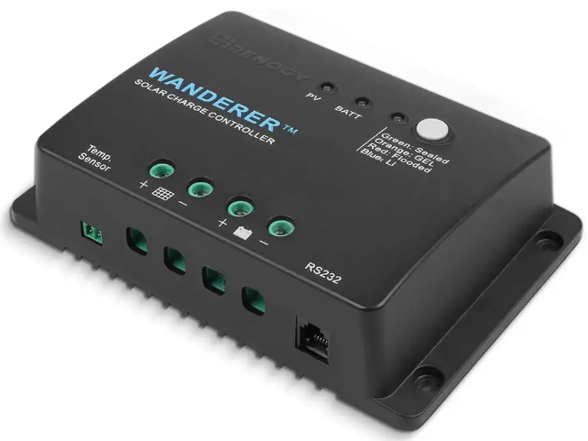
30A PWM Charge Controller
Notes:
$32
Bluetooth adapter available

Slide 9
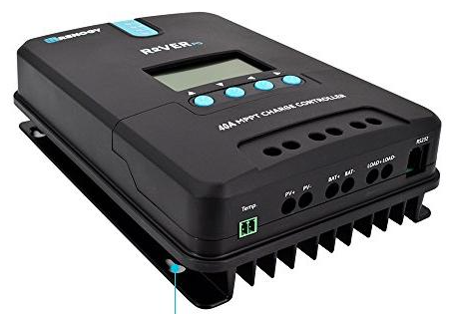
40A MPPT Solar Charge Controller
Notes:
99+% efficient
Bluetooth adapter available
$112
ML2420N • 20A • 12V/24V • Auto 9V to 35V Battery Voltage • Maximum solar input voltage 100v • 260W/12V 520W/24V • ≤98% efficiency • -35℃ to +45℃ IP32 RS232 ≤ 3000m 210*151*59.5mm ML2440N10 40A 550W/12V 1100W/24V 238*173*72.5mm 238*173*72.5mm 1.4Kg

Slide 10
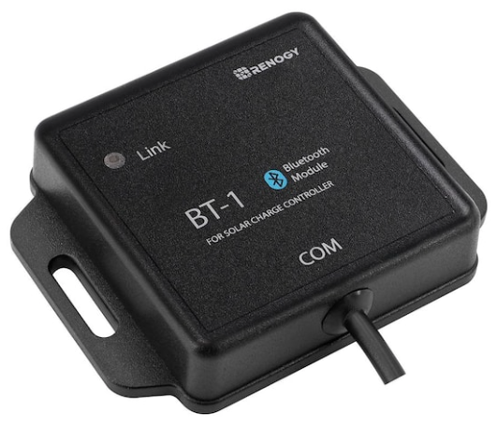
Renogy BT-1 Bluetooth Module
Notes:
Renogy BT-1 Bluetooth module
$32

Slide 11
Deep-Cycle Batteries
Sealed Lead-Acid (SLA)
  Gel Cell
  AGM (Absorbent Glass Matt) batteries
Li-Ion (lithium-Ion)
LiFePO₄ (lithium-iron-phosphate)
LiFeMgPO₄ (lithium-iron-magnesium-phosphate)

Slide 12
Benefits of AGM Batteries
Good option for Ham radio use
Sealed - low maintenance; won’t spill
Heavy
Less expensive

Slide 13
Benefits of LiFePO₄ Batteries
Nearly twice the run-time and a half the mass of a comparatively sized lead-acid battery
Handles high loads better, less voltage drop
May last as long as 3,000 cycles
Nearly maintenance-free
Mounts any orientation, but up recommended
Less fire danger than earlier lithium designs

Slide 14
Comparing Useful Energy Density
Sealed Lead-Acid Battery (12.8V 14Ah)
  179W x .5 = 84 / 5.0Kg = 18W/Kg
Valence LiFeMgPO₄ Battery (13.2V 40Ah)
  528W x 0.8 = 422 / 6.1Kg = 69W/Kg
Calb LiFePO₄ Cell (3.2V 72Ah)
  230W x .8 = 184 / 1.8Kg = 102W/Kg
Notes:
3.8 times more efficient/Kg

Slide 15
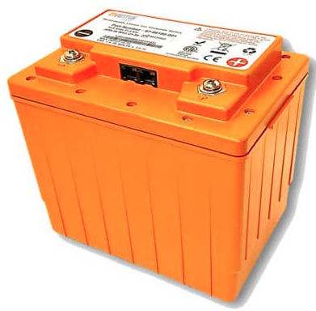

Inventus 12.8v 45Ah LiFePO₄ Batteries

Slide 16
Inventus 12.8v 45Ah LiFePO₄ Batteries
Medical Grade Batteries with BMS
Professionally Tested:
  80-89% - $125
  90-99% - $150
Notes:
12.8V x 45Ah x 573W
Charge and and discharge up to 20 amps continuous.

Slide 17
Charging a LiFePO₄ 12V Battery
Bulk/Absorb: 14.2 – 14.6 Volt; 0 – 2 hours
High charge rate: Capacity/2 (40AH/2 = 20A)
Float: 13.6 Volt or less
Best to stored at a partial charge

Slide 18
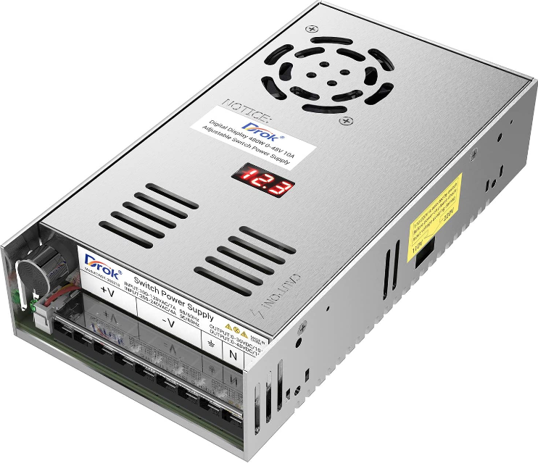
48V 10A Variable Power Supply
Notes:
Use this adjustable power supply with your charge controller is the best universal battery charger.
$40

Slide 19
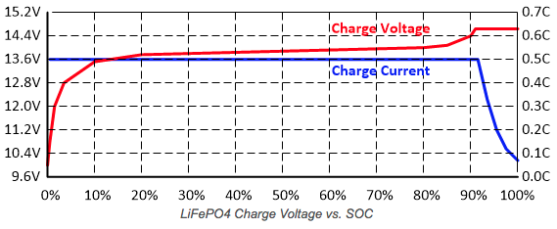
Charging a LiFePO₄ 12V Battery

Slide 20
Discharging a 45AH LiFePO₄ Battery
Maximum continuous discharge: 20 A
Maximum 10 second current pulse: 28 A
Cut-off Voltage: 10V
Run-time @ 10A: 240 minutes
Run-time @ 20A: 120 minutes
Run-time @ 23A: 100 minutes
100W HF radio: 180 minutes

Slide 21
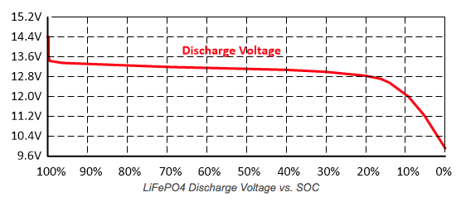
Discharging an LiFePO₄ Battery

Slide 22
Battery Management System (BMS)
Protects from over charge/discharge
Limits charge/discharge currents
Monitors cell temperatures
Balance the cells during charging
You must still use a charge controller

Slide 23
For Long LiFePO₄ Battery Life
Keep the battery temperature under 30˚C
Charge battery above 0˚C
Keep charge/discharge currents under 50% capacity; 20% preferred
Do not cycle battery below 10-15% SOC
Do not float the battery at 100% SOC

Slide 24
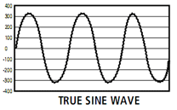
Power Inverters - Converts DC to AC current
Pure Sine Wave Inverter
  Clean power; household AC
  Better for motors and electronics
  Greater efficiency
Notes:
A true sine wave contains the harmonic distortions of the carrier frequency. In other words, it is not a "smooth" sinewave. I believe that in order for an inverter to claim "True Sinewave" output, these ripple distortions must be below 3%.

Slide 25
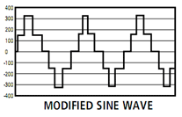
Power Inverters - Converts DC to AC current
Modified Sine Wave Inverter
  Simulates sine wave
  Not compatible with many devices
  Less expensive

Slide 26
Common electronic devices that should not be used with a modified sine wave inverter
Battery chargers
Variable speed tools
Electric shavers
Newer TV’s
Some laptops
Induction cooktops
Items with brushless motors
Coffee makers
Electric blankets
Microwaves
Audio equipment
Laser printers
Many digital clocks
Medical equipment
Notes:
I will choose to use a Pure Sine Wave Inverter because of it's universal use and more energy efficient.

Slide 27
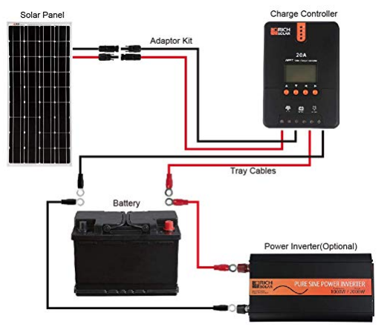
Wiring a Solar Generator

Slide 28
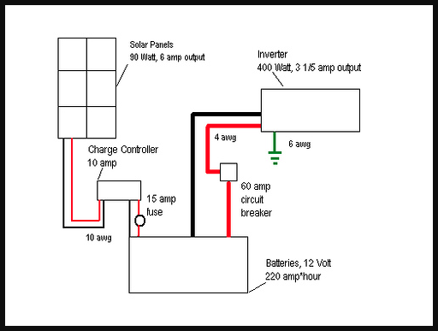
Solar Generator Block Diagram

Slide 29
Costs to Build Your Solar Generator
COMPONENT | COST
100 Watt 12V Solar Panel | $110.00
45Ah LiFePO₄ Battery (Battery Hookup) | $150.00
Solar Charge Controller 30A PWM | $35.00
500W BESTEK Pure Sine Wave Inverter | $55.00
TOTAL | $350.00

Slide 30
Resources
https://sunelec.com/home/
http://ki0bk.no-ip.com
https://www.solacity.com/how-to-keep-lifepo4-lithium-ion-batteries-happy/
https:// https://batteryhookup.com/
Craigslist, eBay, Amazon, Newegg, etc.

Slide 31
Building a Larger-Scale Solar Generator
Back-Up Emergency Power
Off-Grid Power
RV or Camper
Powering medical devices during outages
Power during extended power outages
A level of energy independence

Slide 32
12V Battery Systems
ADVANTAGES:
Multiuse: Ham Radio and other 12V applications
Smaller, more portable applications
Familiar and relatively safe, little chance of electrical shock; greater comfort level

Slide 33
Solar Panels
4 – 290W (used) ET Solar Group Solar Panels
Cells 72 Maximum Power Current: 8.08A
Maximum Power Voltage: 35.92V
77” H 39.1”W x 1.6”D (stationary use)

Slide 34
12V Battery Systems
DISADVANTAGES
You can only use smaller 12-volt devices.
Lower voltage and higher amperage requires larger gauge wire which is more expensive.
A 12-volt solar panel loses a lot of its energy when sending it over long distances.

Slide 35
24V/48V Battery Systems
ADVANTAGES:
It can accommodate a larger solar array.
You can power more larger AC appliances.
Expandable
It is more cost effective, more efficient, experience less transmission loss, and weighs less.

Slide 36
24V/48V Battery Systems
DISADVANTAGES:
You must wear gloves and be extremely careful.
24V/48V can be lethal!

Slide 37
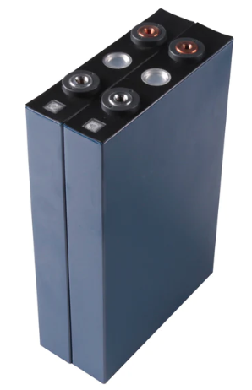
24V Battery System
PRISMATIC CELLS:
8 – 3.2V 72 AH cells in
series (25.6V)
1.843 kW of power

Slide 38
Battery Management System (BMS)
Monitoring the battery
Providing battery protection
Estimating the battery’s operational state
Continually optimizing battery performance
Reporting operational status to external devices

Slide 39
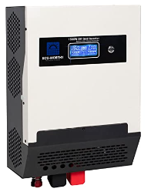
Integrated Components System
COMPONENTS:
50A PWM Solar
Charge Controller
1500W Pure Sine
Wave Inverter
(Battery Charger)
Notes:
Solar Input Voltage Range :30Vdc~60Vdc
Maximum PV Array Wattage: 1200W
Maximum Solar Charge Current: 50A
Rated Power: 1500W
Cells 72 Maximum Power Current: 8.08A
Maximum Power Voltage: 35.92V
4 panels in parallel 35.92V and 32.32A = 1160 W

Slide 40
Wiring a Solar Generator

Slide 41
Cost to Build Larger-Scale Generator
COMPONENT | COST
4-290 Watt Solar Panels (used) | $500.00
8-72Ah Prismatic LiFePO₄ Cells | $320.00
100A BMS with Temperature Sensor & Bluetooth | $70.00
50A PWM Charge Controller/1500W Sine Inverter | $205.00
TOTAL | $1095.00

Slide 42
Show & Tell/Questions & Answers

